Slide 1
Updates in non metastatic Rectal Cancer
Dr . Manal Abo Al Shamat.
8 / 12 / 2022

Slide 2
TNT.
Watch and Wait.
Dostarlimab.

Slide 3
TNT:Total Neoadjuvant Therapy
Historically, the standard of care for locally advanced rectal cancer has been neoadjuvant chemoradiation and total mesorectal excision (TME), followed by adjuvant chemotherapy.
Total neoadjuvant protocols, in which all chemotherapy is delivered up front (induction chemotherapy followed by chemoradiation or chemoradiation followed by consolidation chemotherapy).
Total neoadjuvant therapy (TNT) is now recognized as the preferred standard for the treatment of locally advanced rectal cancer.

Slide 4
TNT
Multiagent systemic chemotherapy regimens such as (FOLFOX) or (capeox) or (FOLFIRINOX) can be given before or after radiation therapy.
TNT offers advantages regardless of the sequence of multiagent chemotherapy and CRT, such as
Allow more patients to complete systemic therapy.
Treat potineal micrometastatic disease earlier.
shortening the interval before ileostomy reversal,
potentially improving the tumor clinical response rate (cCR)
and facilitating organ preservation.

Slide 5
TNT
The phase III PRODIGE trial randomized 461 patients with locally advanced rectal cancer to Arm A pts received preop CRT, surgery, then adjuvant CT for 6 months. Arm B pts received 6 cycles of mFOLFIRINOX every 14 days, followed by preop CRT, surgery and 3 mos of adjuvant CT. Adjuvant CT consisted of mFOLFOX6 or capecitabine.
The trial showed an improvement in the primary end point of 3-years DFS with the TNT approach (75.5% vs 68.5% , HR,0.69;95%CI,0.49-0.97)
There was also an improvement in the pCR rate (27.5% vs 11.7%;P<.001) with the TNT approach.

Slide 6
TNT
The phase III RAPIDO trial randomized 920 patients with locally advanced rectal cancer to experimental treatment group received short-course radiotherapy followed by 6 cycles of CAPOX or 8 cycles of FOLFOX4 followed by total mesorectal excision. Patients allocated to the standard of care group received long course , with concomitant capecitabine followed by total mesorectal excision and, adjuvant chemotherapy with 8 cycles of CAPOX or 12 cycles of FOLFOX4.
Similar to the PRODIGE 23 trial, the TNT arm in the rapido trial also showed a stastically significant improvement in the primary endpoint of 3-year disease related treatment failure (19.8% vs 26.6%) and in the pCR rate (27.7% vs 13.8%; P>.001)

Slide 7
TNT
Two Europian studies PRODIGE trial and RAPIDO trial showed that (TNT) is considered the preferred strategy in the management of rectal carcinoma T3 or higher, N1 or higher, locally unresectable or medically unoperable patients.

Slide 8
Watch and Wait
In patients who have a complete clinical response to neoadjuvant therapy, with no evidence of residual disease on digital rectal examination, rectal MRI, and direct endoscopic evaluation, a watch-and-wait nonoperative management approach may be considered, in centers with experienced multidisciplinary teams.

Slide 9
Watch and Wait
The International Watch & Wait Database (IWWD) aims to collect data on the benefits, risks, and safety of organ preservation in rectal cancer using a large-scale registry of pooled individual patient data from multiple institutions.
A 2018 analysis included data from 880 patients in the IWWD with disease that had a complete clinical response after neoadjuvant therapy and were managed using watch-and-wait. the 2-year incidence of local recurrence was 25.2% and 88% of local recurrences occurred in the first 2 years. Distant metastases occurred in 8% of patients, 5-year OS was 85%, and 5-year disease-specific survival was 94%.
A 2021 analysis of the IWWD showed similar results.
current data from the IWWD suggest that disease recurrence occurs most frequently in the first 2–3 years after complete response.

Slide 10
Watch and Wait
Data from the Organ Preservation in Rectal Adenocarcinoma (OPRA) trial (NCT02008656) were published in the Journal of Clinical Oncology in August 2022, showed similar result.

Slide 11
Watch and Wait
Results of the open-label, multicenter, phase 2 (OPRA) trial, which randomized patients to either induction chemotherapy with FOLFOX or capeox for 4 months followed by capecitabine and radiotherapy (INCT-CRT) or the reverse sequence of CRT followed by consolidation chemotherapy (CRT-CNCT). Total mesorectal excision (TME) was performed in patients not achieving a clinical complete response.
Of 324 patients, with stage III cancers that were T3 (77%), node positive (71%), and less than 5 cm from the anal verge. At a median follow-up of 3 years, disease-free survival, the primary endpoint, was similar for the INCT-CRT and CRT-CNCT arms (76% and 76%) and was not superior to an historical rate of 75% in patients undergoing conventional chemoradiotherapy followed by surgery. Local recurrence-free survival (94% and 94%) and distant metastasis free survival (84% and 82%) were also similar in the two treatment arms.
A watch-and-wait approach was offered to 71% of the INCT-CRT patients and 76% of the CRT-CNCT patients, with 40% and 27%, respectively, developing local tumor regrowth.
The CRT-CNCT group had a higher rate of TME-free survival at 3 years than the INCT-CRT group (60% vs. 47%; P=0.02).

Slide 12
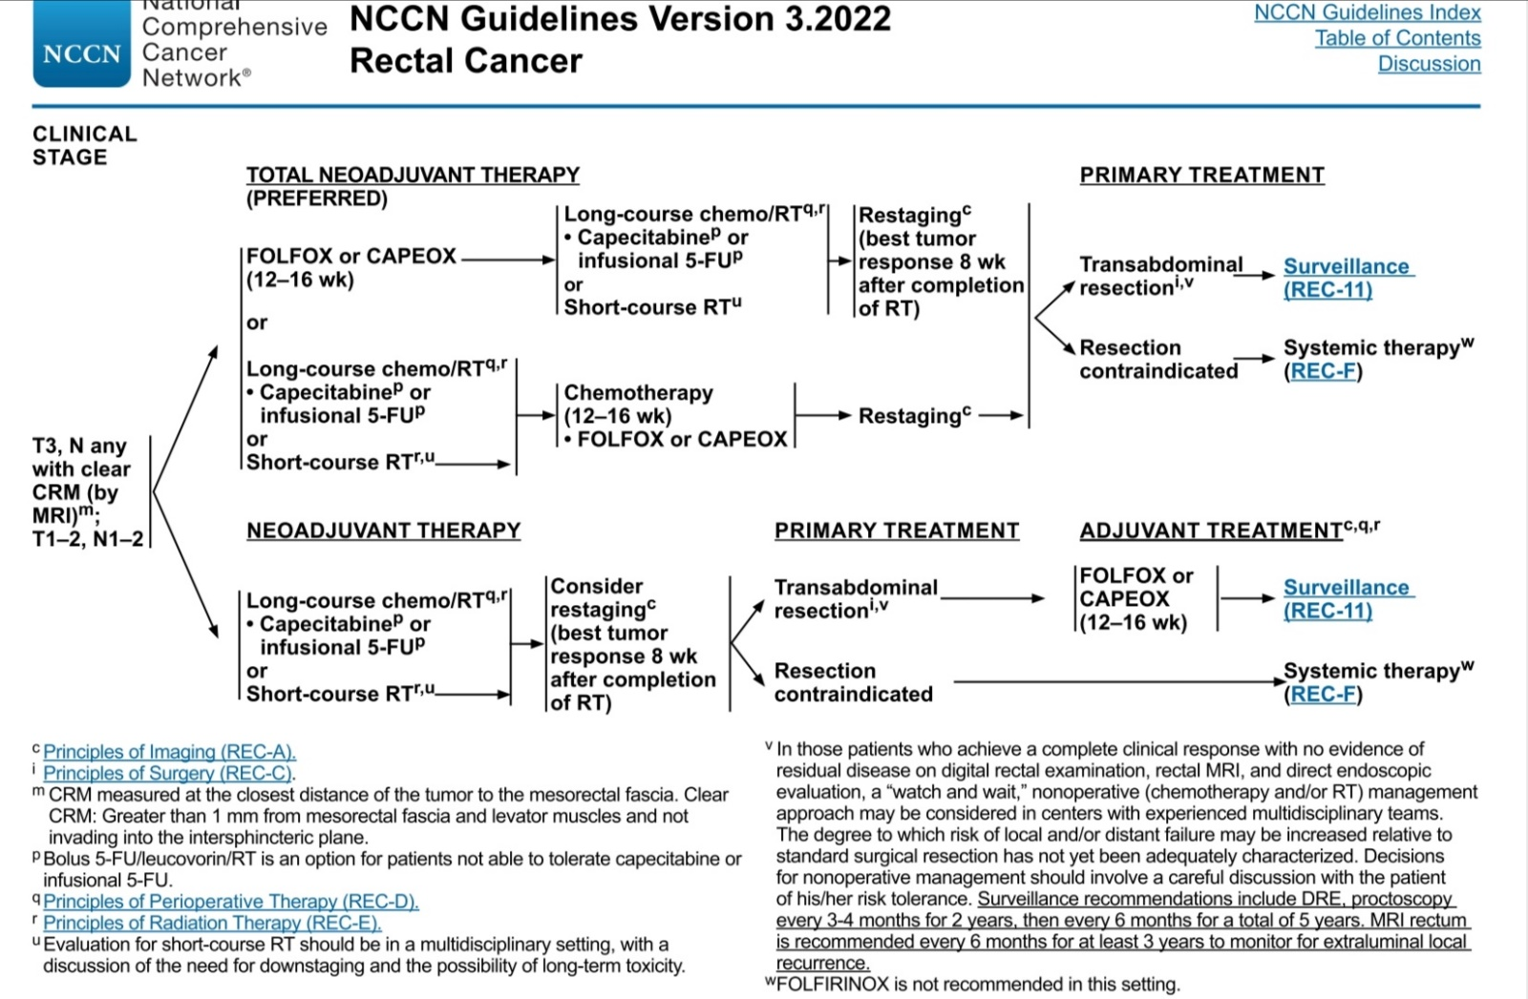

Slide 13
Dostarlimab
Neoadjuvant chemotherapy and radiation followed by surgical resection of the rectum is a standard treatment for locally advanced rectal cancer
A subset (5 to 10%) of rectal cancer is caused by a deficiency in mismatch repair
Because mismatch repair–deficient colorectal cancer is responsive to programmed death 1 (PD-1) blockade in the context of metastatic disease, it was hypothesized that checkpoint blockade could be effective in patients with mismatch repair–deficient, locally advanced rectal cancer
N ENGL J MED 386;25 nejm.org June 23, 2022

Slide 14

Methods
A prospective phase 2 study in which single-agent dostarlimab, an anti–PD-1 monoclonal antibody, was administered every 3 weeks for 6 months in patients with mismatch repair–deficient stage II or III rectal adenocarcinoma
This treatment was to be followed by standard chemoradiotherapy and surgery
Patients who had a clinical complete response after completion of dostarlimab therapy would proceed without chemoradiotherapy and surgery

Slide 15
Methods
The primary end points are sustained clinical complete response 12 months after completion of dostarlimab therapy or pathological complete response after completion of dostarlimab therapy with or without chemoradiotherapy and overall response to neoadjuvant dostarlimab therapy with or without chemoradiotherapy

Slide 16
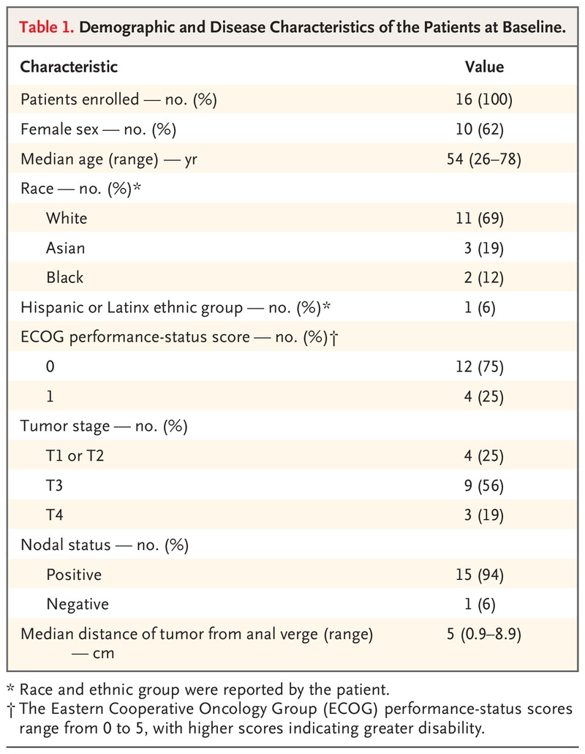
Patient Characteristics

Slide 17
Results
A total of 12 patients have completed treatment with dostarlimab and have undergone at least 6 months of follow-up
All 12 patients (100%; 95% confidence interval, 74 to 100) had a clinical complete response, with no evidence of tumor on MRI, ¹⁸FDG PET CT, endoscopic evaluation, digital rectal examination, or biopsy
At the time of this report, no patients had received chemoradiotherapy or undergone surgery, and no cases of progression or recurrence had been reported during follow-up (range, 6 to 25 months)
No adverse events of grade 3 or higher have been reported

Slide 18
Evolution of Endoscopic and Radiographic Response in Representative Patients Treated with Dostarlimab

Slide 19
Evolution of Endoscopic and Radiographic Response in Representative Patients Treated with Dostarlimab

Slide 20
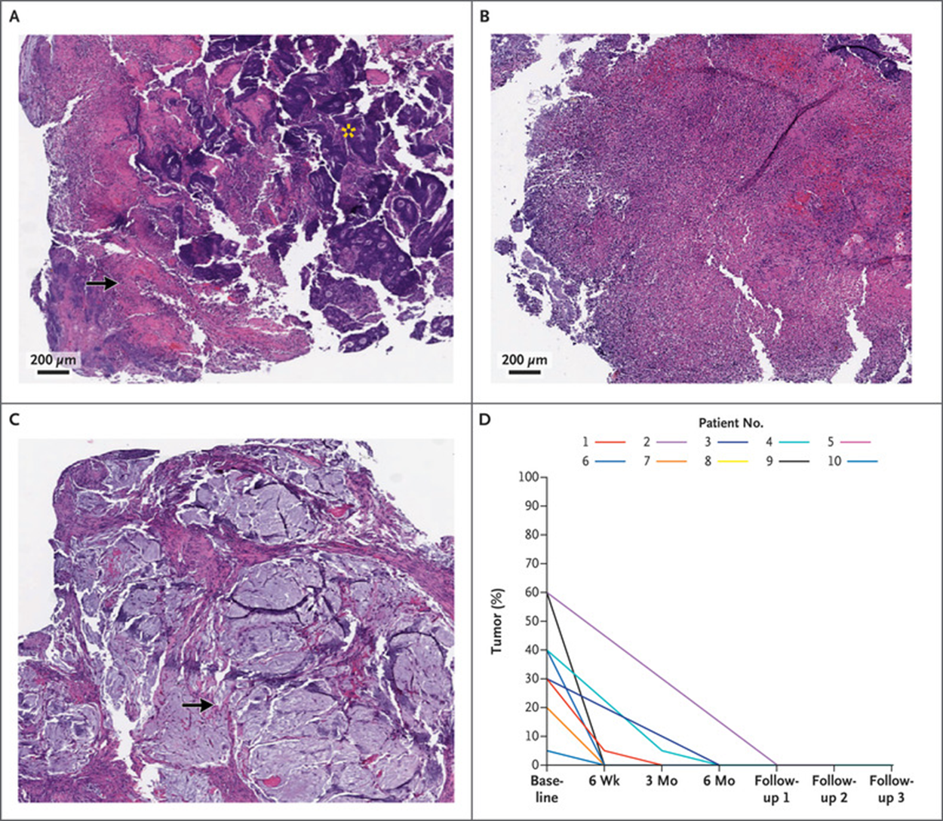
Biopsy Specimens of the Rectum before and after PD1 Blockade and Viable Tumor Cell Content
Hematoxylin and eosin staining of representative biopsy specimens obtained at baseline (Panels A and B) shows examples of viable tumor cells (Panel A, asterisk) surrounded by necrosis (Panel A, arrow) and extensive necrosis and inflammation with scant viable tumor cells (Panel B). Staining of representative biopsy specimens obtained at 3 months after initiation of treatment (Panel C) shows the presence of acellular residual mucin pools (arrow). Also shown (Panel D) are the estimated percentages of viable tumor cells on pathological exami‑ nation of specimens obtained before treatment (baseline), during treatment (6 weeks through 6 months), and during follow‑up in 10 pa‑ tients. PD‑1 denotes programmed death 1.

Slide 21
Conclusions
Mismatch repair–deficient, locally advanced rectal cancer was highly sensitive to single-agent PD-1 blockade
Longer follow-up is needed to assess the duration of response

